Slide 1
Proposal for Government Zonal Hospitals - Mumbai

Slide 2
Backdrop…
Medical care has become very expensive
80% of Indian Population can’t afford corporate hospitals
Government hospitals are very few
Traffic in metropolitan cities like Delhi, Mumbai, Kolkata, Chennai and in major cities like Hyderabad, Bangalore etc. is becoming bad to worse
There are many cases where a patient died on the way to an affordable hospital
In this scenario, it’s very important to have a government hospital or government aided hospitals in close vicinities
Pin code( or postal code),very prevalent in India , is a means of grouping areas
Each city has few to many pin codes, depending on the size of the city and its spread
So, Pin code can be safe and strong base to cluster the areas in a city

Slide 3
Proposed Solution
The solution proposed here is to identify at least one hospital in each area (Pin Code) that government can take over or provide aid, so that it becomes economically affordable to all the people.
In case where there is no hospital in that area(Pin Code), a hospital in the cluster, where this Pin Code is grouped into, is selected.
If there is no hospital even in the cluster, then a proposal to build a government hospital in that cluster, is suggested.

Slide 4
Data Extract and cleaning
The list of Pin codes with the names of the areas are extracted from https://worldpostalcode.com/india/maharashtra/mumbai/
The Latitude and Longitude for these areas are found with the help of Nominatim.
The Pin codes for which the latlong could not be found, will be dropped
Foursqare API is used to get the list of all hospitals in that particular Pin codes (using latlong found from Nominatim)
The Pin Codes are then grouped, on the basis of latitude and longitude.
This grouping is done by Kmeans. An appropriate value of K is found by examining the “Sum_of_squared_distances” for each value of K, over a range of values.
This data is then processed, to find the suggestion of a Hospital name in every area. Then government can aid this hospital to make it economically affordable to everyone.

Slide 5

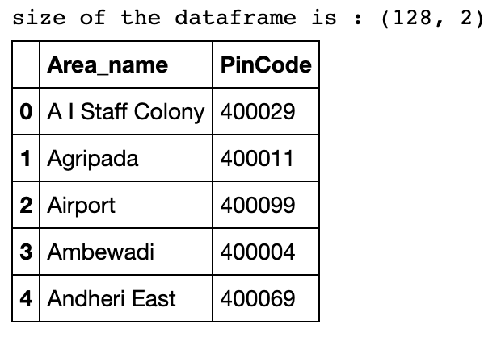
Pin code and Area name extract
The Pin Code and the area name is extracted from https://worldpostalcode.com/india/maharashtra/mumbai/
This raw data is then cleaned using “BeautifulSoup”
A dataframe with Area name and Pin code is created, this is the starting data which will later be processed

Slide 6
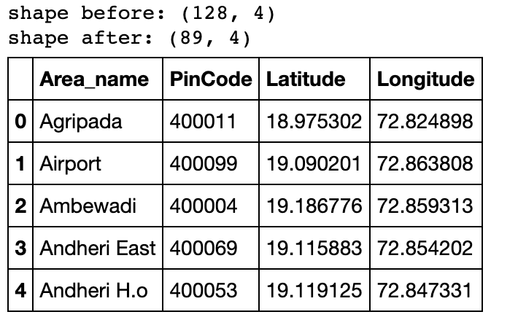
Latitude and Longitude for PIN Codes
The latitude and longitude are found with the help of Nominatim and then are added.

Slide 7
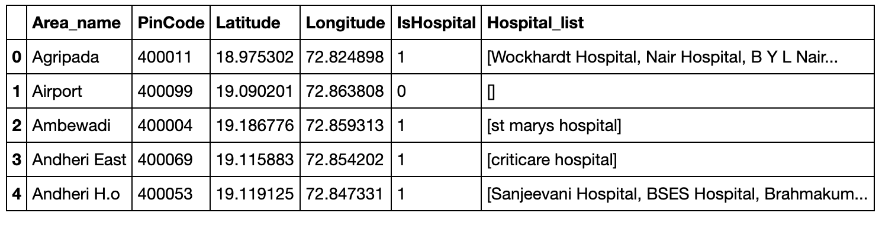
Foursquare API
Foursquare API is used to check if there is any hospital in the Pin Code (latlong) and if there is then the list of all hospitals is extracted and is added.

Slide 8
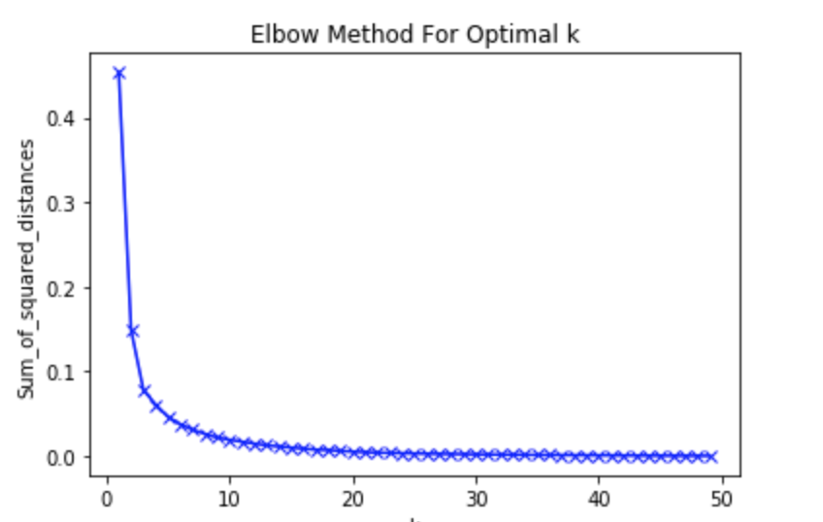
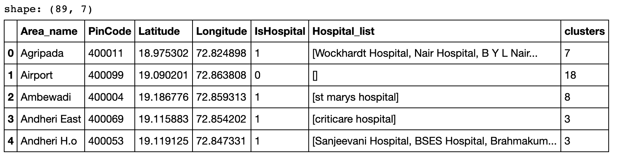
Clustering
Multiple times clustering, resulted in a different shaped
cluster each time, but there was no affect after that
The City is clustered on latlong, using Kmeans.
Finding Optimum K
The cluster numbers added

Slide 9
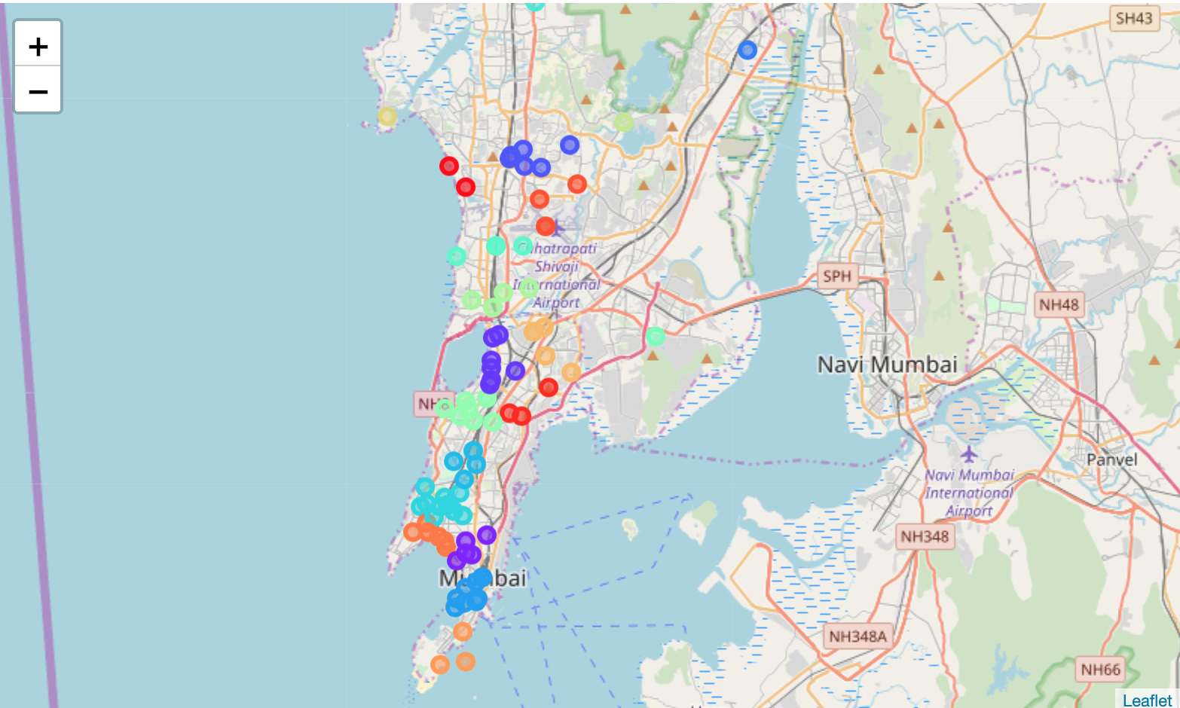
Folium Map for clusters

Slide 10
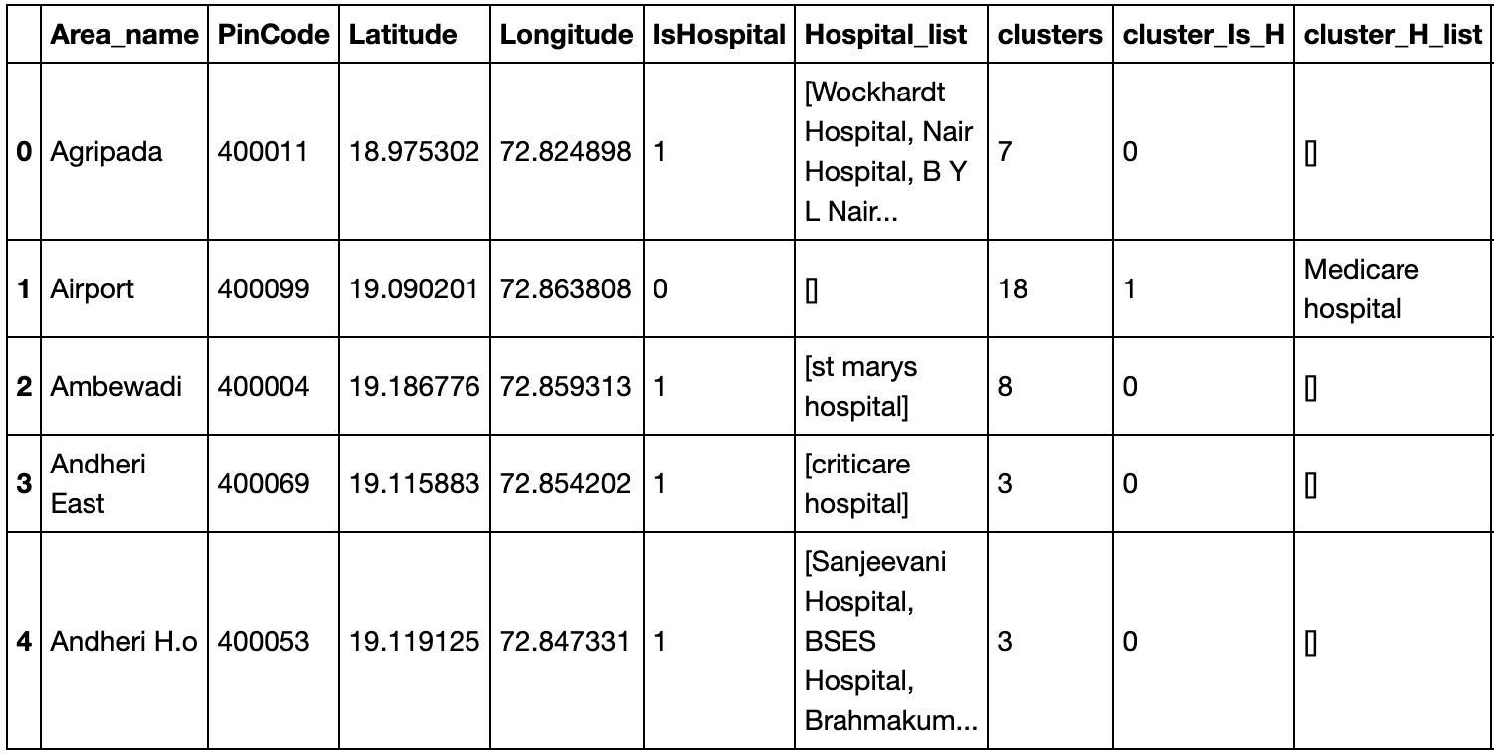
Hospital At cluster
For all the Pin Codes that doesn’t have a hospital, check is performed to find a hospital in the cluster. If present then that hospital is added.
If not present, “No hospital Present” is written

Slide 11
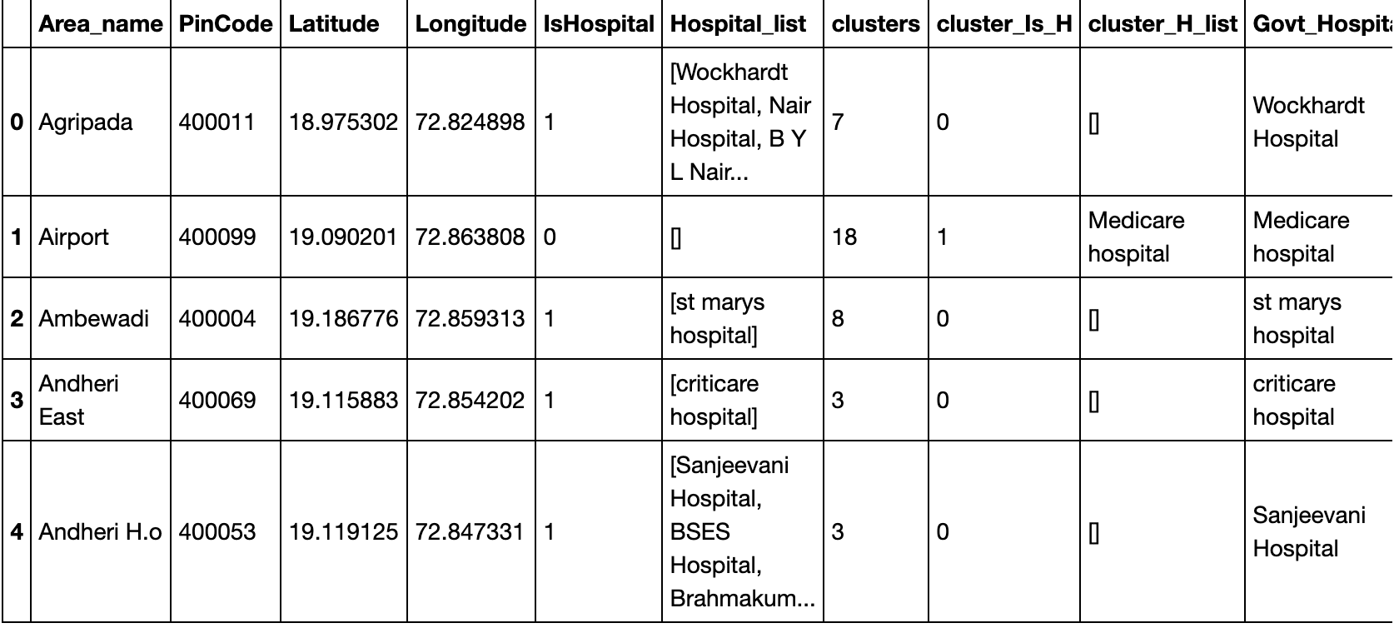
Final Result
Finally one more column added, which suggests the name of the hospital either from the hospitals in the Pin Code or from the hospitals in the Cluster(for cases where there is no hospital in the Pin Code.
The suggested name of the hospital is selected randomly.
The best bet would be to include the ratings of a hospital, in the selection process.

Slide 12
Conclusion and Suggestions
The suggestion would be to pick the suggested hospital and provide aid, so that medical care in that hospital will be affordable.
According to the observations during the process, there are at least 3 or 4 Pin Code that does not have hospital either in the Pin Code or at the cluster level.
This is a depressing fact.
May be a new hospital in each of this cluster should be built.

